Slide 1
CHAPTER 3
STACKS AND QUEUES
Dr. Nagaratna P Hegde
CHAPTER 3

Slide 2
A
stack: a Last-In-First-Out (LIFO) list
B
A
C
B
A
D
C
B
A
E
D
C
B
A
top
D
C
B
A
top
top
top
top
top
*Figure 3.1: Inserting and deleting elements in a stack (p.102)
CHAPTER 3

Slide 3
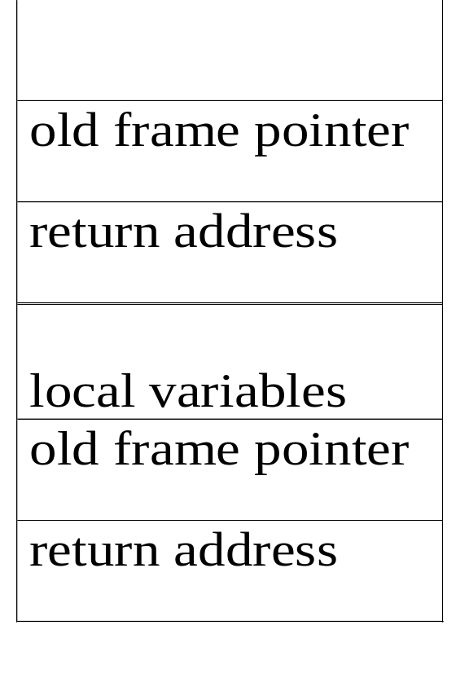
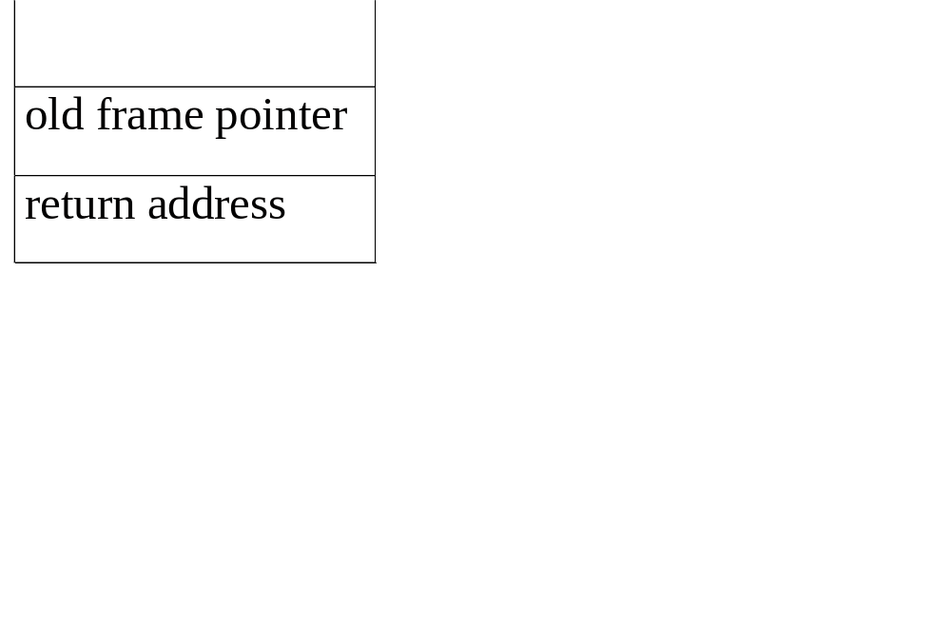
an application of stack: stack frame of function call
(activation record)
fp: a pointer to current stack frame
fp
al
fp
main
stack frame of invoking function
system stack before a1 is invoked
system stack after a1 is invoked
(a) (b)
*Figure 3.2: System stack after function call a1 (p.103)
CHAPTER 3

Slide 4
structure Stack is objects: a finite ordered list with zero or more elements. functions: for all stack ∈ Stack, item ∈ element, max_stack_size
∈ positive integer
Stack CreateS(max_stack_size) ::= create an empty stack whose maximum size is max_stack_size
Boolean IsFull(stack, max_stack_size) ::= if (number of elements in stack == max_stack_size) return TRUE else return FALSE
Stack Add(stack, item) ::= if (IsFull(stack)) stack_full else insert item into top of stack and return
abstract data type for stack
CHAPTER 3

Slide 5
Boolean IsEmpty(stack) ::= if(stack == CreateS(max_stack_size)) return TRUE else return FALSE
Element Delete(stack) ::= if(IsEmpty(stack)) return else remove and return the item on the top of the stack.
*Structure 3.1: Abstract data type Stack (p.104)
CHAPTER 3

Slide 6
Stack CreateS(max_stack_size) ::=
#define MAX_STACK_SIZE 100 /* maximum stack size */ typedef struct { int key;
/* other fields */
} element; element stack[MAX_STACK_SIZE]; int top = -1;
Boolean IsEmpty(Stack) ::= top< 0;
Boolean IsFull(Stack) ::= top >= MAX_STACK_SIZE-1;
Implementation: using array
CHAPTER 3

Slide 7
void add(int *top, element item)
{
/* add an item to the global stack */ if (*top >= MAX_STACK_SIZE-1) { stack_full( ); return;
} stack[++*top] = item;
}
*program 3.1: Add to a stack (p.104)
Add to a stack
CHAPTER 3

Slide 8
element delete(int *top)
{
/* return the top element from the stack */ if (*top == -1) return stack_empty( ); /* returns and error key */ return stack[(*top)--];
}
*Program 3.2: Delete from a stack (p.105)
Delete from a stack
CHAPTER 3

Slide 9
( 3 + 4-5 /7 ) * (6/8-(5*7^4) *1) -4 /8
i/p | Stack | o/p
( | (
3 | ( | 3
+ | (+ | 3
4 | (+ | 34
- | (- | 34+
5 | (- | 34+5
/ | (-/ | 34+5
7 | (-/ | 34+57
) |  | 34+57/-
* | * | 34+57/-
( | *( | 34+57/-
6 | *( | 34+57/-6
CHAPTER 3

Slide 10
/ | *(/ | 34+57/-6
8 | *(/ | 34+57/-68
- | *(- | 34+57/-68/
( | *(-( | 34+57/-68/
5 | *(-( | 34+57/-68/5
* | *(-(* | 34+57/-68/5
7 | *(-(* | 34+57/-68/57
^ | *(-(*^ | 34+57/-68/57
4 | *(-(*^ | 34+57/-68/574
) | *(- | 34+57/-68/574^*
* | *(-* | 34+57/-68/574^*
1 | *(-* | 34+57/-68/574^*1
) | * | 34+57/-68/574^*1*-
- | - | 34+57/-68/574^*1*-*
4 | - | 34+57/-68/574^*1*-*4
/ | -/ | 34+57/-68/574^*1*-*4
8 | -/ | 34+57/-68/574^*1*-*48
 |  | 34+57/-68/574^*1*-*48/-
CHAPTER 3

Slide 11
Queue: a First-In-First-Out (FIFO) list
A
B
A
C
B
A
D
C
B
A
rear
front
D
C
B
rear
front
rear
front
rear
front
rear
front
*Figure 3.4: Inserting and deleting elements in a queue (p.106)
CHAPTER 3

Slide 12
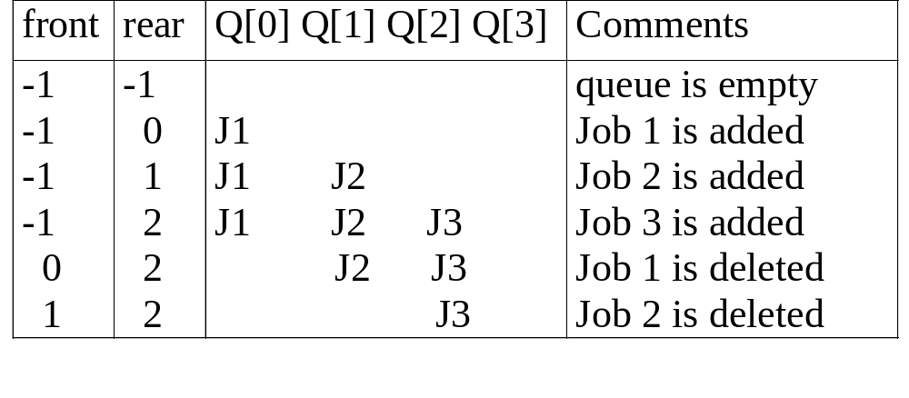
Application: Job scheduling
*Figure 3.5: Insertion and deletion from a sequential queue (p.108)
CHAPTER 3

Slide 13
structure Queue is objects: a finite ordered list with zero or more elements. functions: for all queue ∈ Queue, item ∈ element, max_ queue_ size ∈ positive integer
Queue CreateQ(max_queue_size) ::= create an empty queue whose maximum size is max_queue_size
Boolean IsFullQ(queue, max_queue_size) ::= if(number of elements in queue == max_queue_size) return TRUE else return FALSE
Queue AddQ(queue, item) ::= if (IsFullQ(queue)) queue_full else insert item at rear of queue and return queue
Abstract data type of queue
CHAPTER 3

Slide 14
Boolean IsEmptyQ(queue) ::= if (queue ==CreateQ(max_queue_size)) return TRUE else return FALSE
Element DeleteQ(queue) ::= if (IsEmptyQ(queue)) return else remove and return the item at front of queue.
*Structure 3.2: Abstract data type Queue (p.107)
CHAPTER 3

Slide 15
Queue CreateQ(max_queue_size) ::=
# define MAX_QUEUE_SIZE 100/* Maximum queue size */ typedef struct { int key;
/* other fields */
} element; element queue[MAX_QUEUE_SIZE]; int rear = -1; int front = -1;
Boolean IsEmpty(queue) ::= front == rear
Boolean IsFullQ(queue) ::= rear == MAX_QUEUE_SIZE-1
Implementation 1: using array
 |  |  |  |  | 6 | 7 | 8 | 9 | 7
CHAPTER 3

Slide 16
void addq(int *rear, element item)
{
/* add an item to the queue */ if (*rear == MAX_QUEUE_SIZE_1) { queue_full( ); return;
} queue [++*rear] = item;
}
*Program 3.3: Add to a queue (p.108)
Add to a queue
CHAPTER 3

Slide 17
element deleteq(int *front, int rear)
{
/* remove element at the front of the queue */ if ( *front == rear) return queue_empty( ); /* return an error key */ return queue [++ *front];
}
*Program 3.4: Delete from a queue(p.108) problem: there may be available space when IsFullQ is true
I.E. movement is required.
Delete from a queue
CHAPTER 3

Slide 18
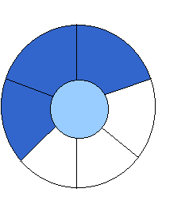
Implementation 2: regard an array as a circular queue
front: one position counterclockwise from the first element
rear: current end 5 (4+1)%6
EMPTY QUEUE
[2]
[3] [2] [3]
J2
J3
[1] [4] [1] [4]
J1
[0] [5] [0] [5]
front = 0 front = 0
rear = 0 rear = 3
*Figure 3.6: Empty and nonempty circular queues
CHAPTER 3

Slide 19

Problem: one space is left when queue is full
FULL QUEUE FULL QUEUE
[2] [3] [2] [3]
J2 J3
J8 J9
J7
[1] [4][1] [4]
J1 J4
J5
J6 J5
[0] [5] [0] [5]
front =0
rear = 5
front =4
rear =3
*Figure 3.7: Full circular queues and then we remove the item (p.110)
CHAPTER 3

Slide 20
void addq(int front, int *rear, element item)
{
/* add an item to the queue */
*rear = (*rear +1) % MAX_QUEUE_SIZE; if (front == *rear) /* reset rear and print error */ return;
} queue[*rear] = item;
}
*Program 3.5: Add to a circular queue (p.110)
Add to a circular queue
CHAPTER 3

Slide 21
element deleteq(int* front, int rear)
{ element item;
/* remove front element from the queue and put it in item */ if (*front == rear) return queue_empty( );
/* queue_empty returns an error key */
*front = (*front+1) % MAX_QUEUE_SIZE; return queue[*front];
}
*Program 3.6: Delete from a circular queue (p.111)
Delete from a circular queue
CHAPTER 3

Slide 22
A Mazing Problem
0 1 0 0 0 1 1 0 0 0 1 1 1 1 1
1 0 0 0 1 1 0 1 1 1 0 0 1 1 1
0 1 1 0 0 0 0 1 1 1 1 0 0 1 1
1 1 0 1 1 1 1 0 1 1 0 1 1 0 0
1 1 0 1 0 0 1 0 1 1 1 1 1 1 1
0 0 1 1 0 1 1 1 0 1 0 0 1 0 1
0 1 1 1 1 0 0 1 1 1 1 1 1 1 1
0 0 1 1 0 1 1 0 1 1 1 1 1 0 1
1 1 0 0 0 1 1 0 1 1 0 0 0 0 0
0 0 1 1 1 1 1 0 0 0 1 1 1 1 0
0 1 0 0 1 1 1 1 1 0 1 1 1 1 0
entrance
exit
1: blocked path 0: through path
*Figure 3.8: An example maze(p.113)
CHAPTER 3

Slide 23
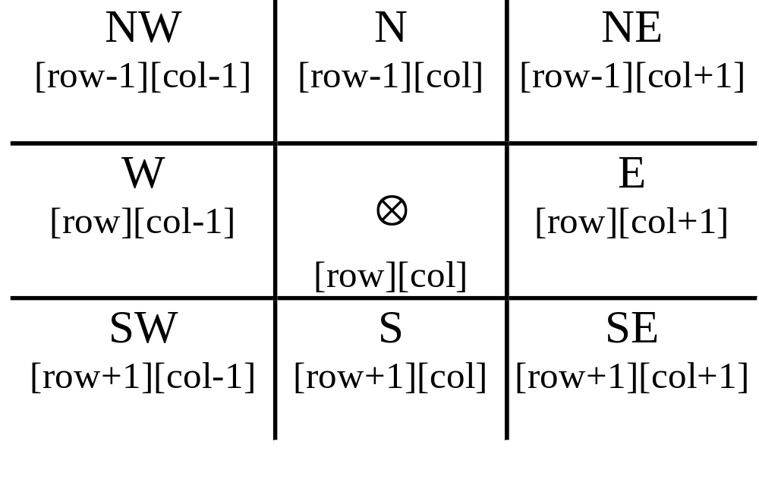
a possible representation
*Figure 3.9: Allowable moves (p.113)
CHAPTER 3

Slide 24
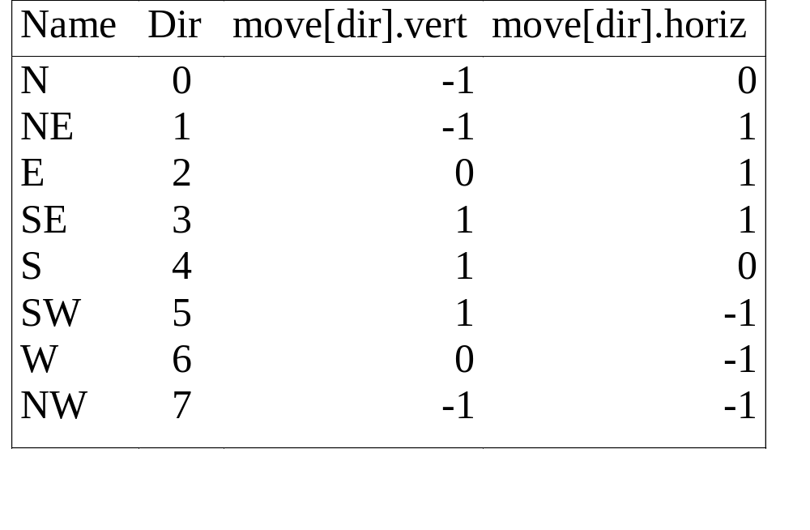
typedef struct { short int vert; short int horiz;
} offsets; offsets move[8]; /*array of moves for each direction*/
a possible implementation
next_row = row + move[dir].vert;
next_col = col + move[dir].horiz;
CHAPTER 3

Slide 25
#define MAX_STACK_SIZE 100
/*maximum stack size*/ typedef struct { short int row; short int col; short int dir;
} element; element stack[MAX_STACK_SIZE];
Use stack to keep pass history
CHAPTER 3

Slide 26
Initialize a stack to the maze’s entrance coordinates and direction to north; while (stack is not empty){
/* move to position at top of stack */
<row, col, dir> = delete from top of stack; while (there are more moves from current position) {
<next_row, next_col > = coordinates of next move; dir = direction of move; if ((next_row == EXIT_ROW)&& (next_col == EXIT_COL)) success; if (maze[next_row][next_col] == 0 && mark[next_row][next_col] == 0) {
CHAPTER 3

Slide 27
/* legal move and haven’t been there */ mark[next_row][next_col] = 1;
/* save current position and direction */ add <row, col, dir> to the top of the stack; row = next_row; col = next_col; dir = north;
}
}
} printf(“No path found\n”);
*Program 3.7: Initial maze algorithm (p.115)
CHAPTER 3

Slide 28
The size of a stack?
000001
111110
100001
011111
100001
111110
100001
011111
100000
m*p
mp --> ┌ m/2┐p, mp --> ┌ p/2┐m
*Figure 3.11: Simple maze with a long path (p.116)
CHAPTER 3

Slide 29
void path (void)
{
/* output a path through the maze if such a path exists */ int i, row, col, next_row, next_col, dir, found = FALSE; element position; mark[1][1] = 1; top =0; stack[0].row = 1; stack[0].col = 1; stack[0].dir = 1; while (top > -1 && !found) { position = delete(&top); row = position.row; col = position.col; dir = position.dir; while (dir < 8 && !found) {
/*move in direction dir */ next_row = row + move[dir].vert; next_col = col + move[dir].horiz;
(1,1)
(m,p)
(m+2)*(p+2)
0
7 N 1
6 W E 2
5 S 3
4
CHAPTER 3

Slide 30
if (next_row==EXIT_ROW && next_col==EXIT_COL) found = TRUE; else if ( !maze[next_row][next_col] &&
!mark[next_row][next_col] { mark[next_row][next_col] = 1; position.row = row; position.col = col; position.dir = ++dir; add(&top, position); row = next_row; col = next_col; dir = 0;
} else ++dir;
}
}
CHAPTER 3

Slide 31
if (found) { printf(“The path is :\n”); printf(“row col\n”); for (i = 0; i <= top; i++) printf(“ %2d%5d”, stack[i].row, stack[i].col); printf(“%2d%5d\n”, row, col); printf(“%2d%5d\n”, EXIT_ROW, EXIT_COL);
} else printf(“The maze does not have a path\n”);
}
*Program 3.8:Maze search function (p.117)
CHAPTER 3

Slide 32
X = a / b - c + d * e - a * c a = 4, b = c = 2, d = e = 3
Interpretation 1:
((4/2)-2)+(3*3)-(4*2)=0 + 8+9=1
Interpretation 2:
(4/(2-2+3))*(3-4)*2=(4/3)*(-1)*2=-2.66666…
How to generate the machine instructions corresponding to a given expression? precedence rule + associative rule
Evaluation of Expressions
CHAPTER 3

Slide 33
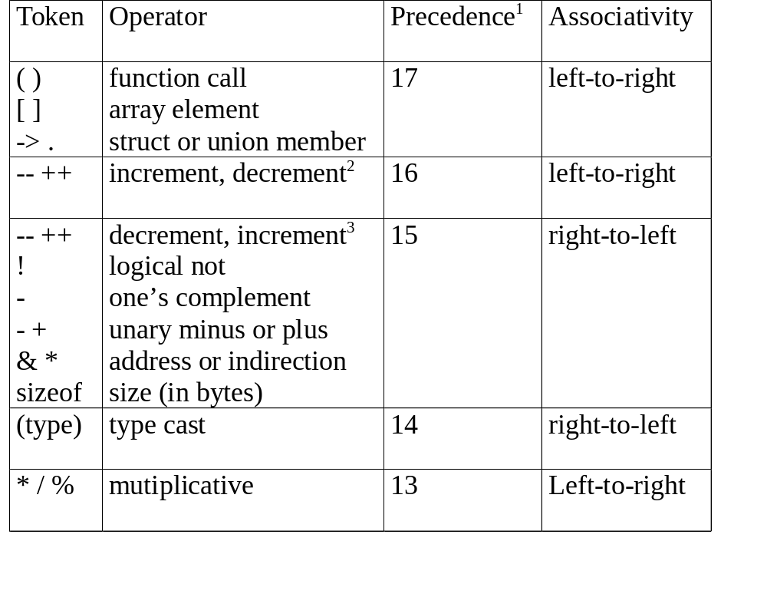
CHAPTER 3

Slide 34
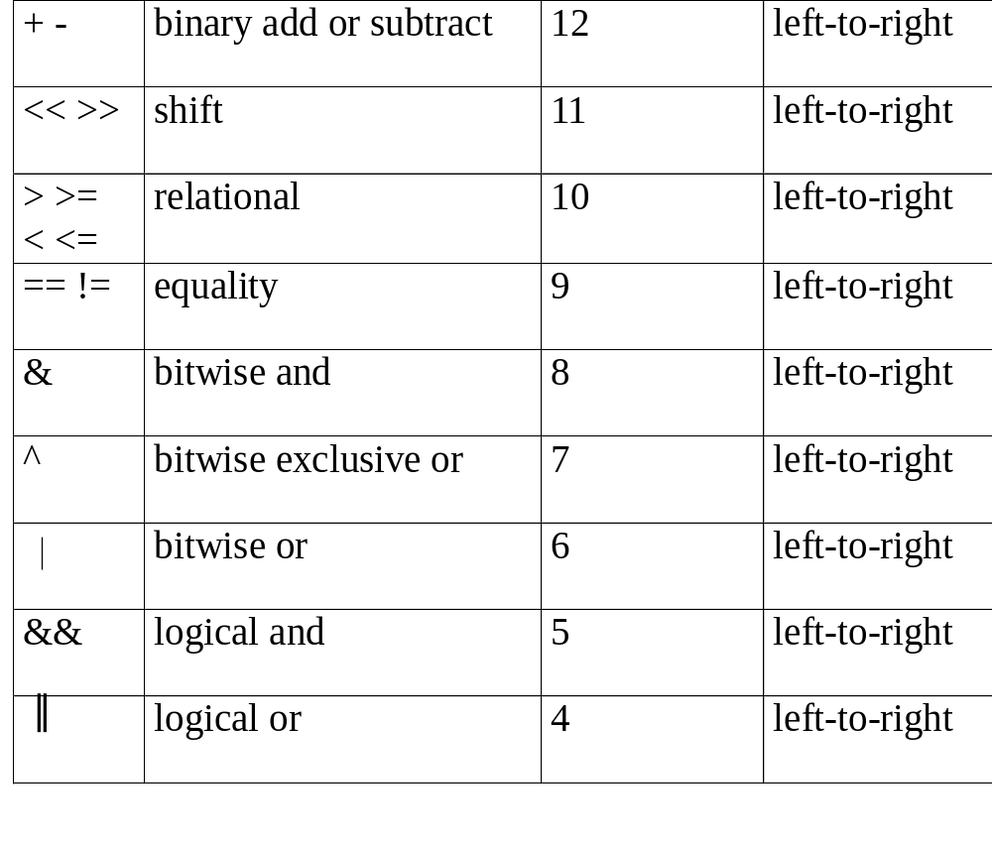
CHAPTER 3

Slide 35
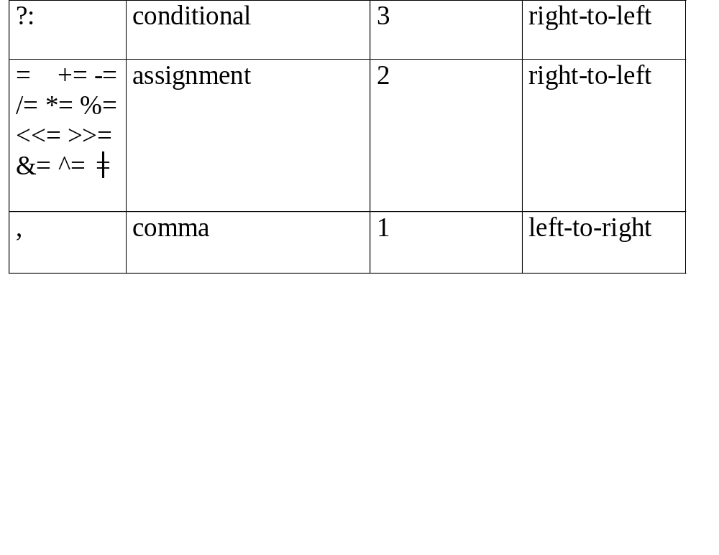
1.The precedence column is taken from Harbison and Steele.
2.Postfix form
3.prefix form
*Figure 3.12: Precedence hierarchy for C (p.119)
CHAPTER 3

Slide 36
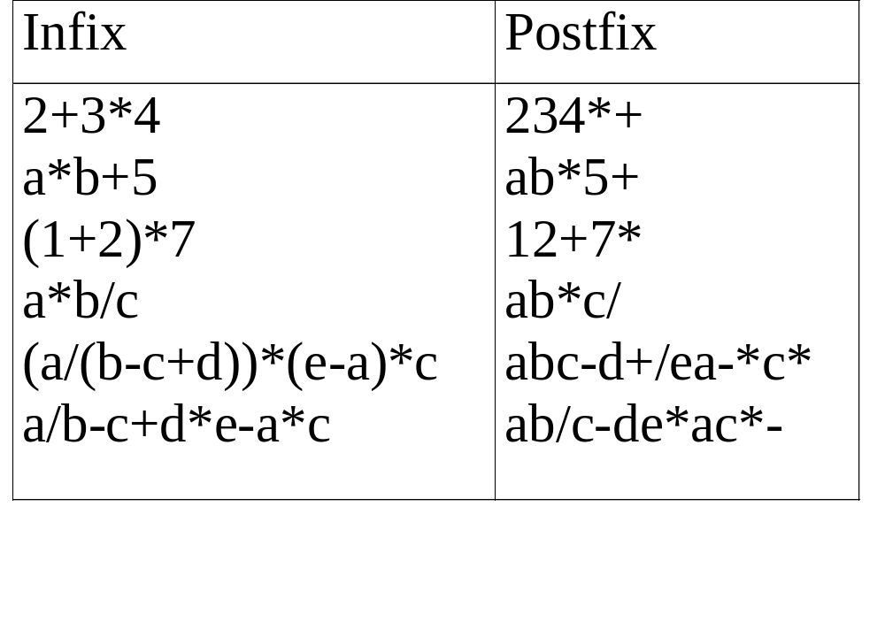
user
compiler
*Figure 3.13: Infix and postfix notation (p.120)
Postfix: no parentheses, no precedence
CHAPTER 3

Slide 37
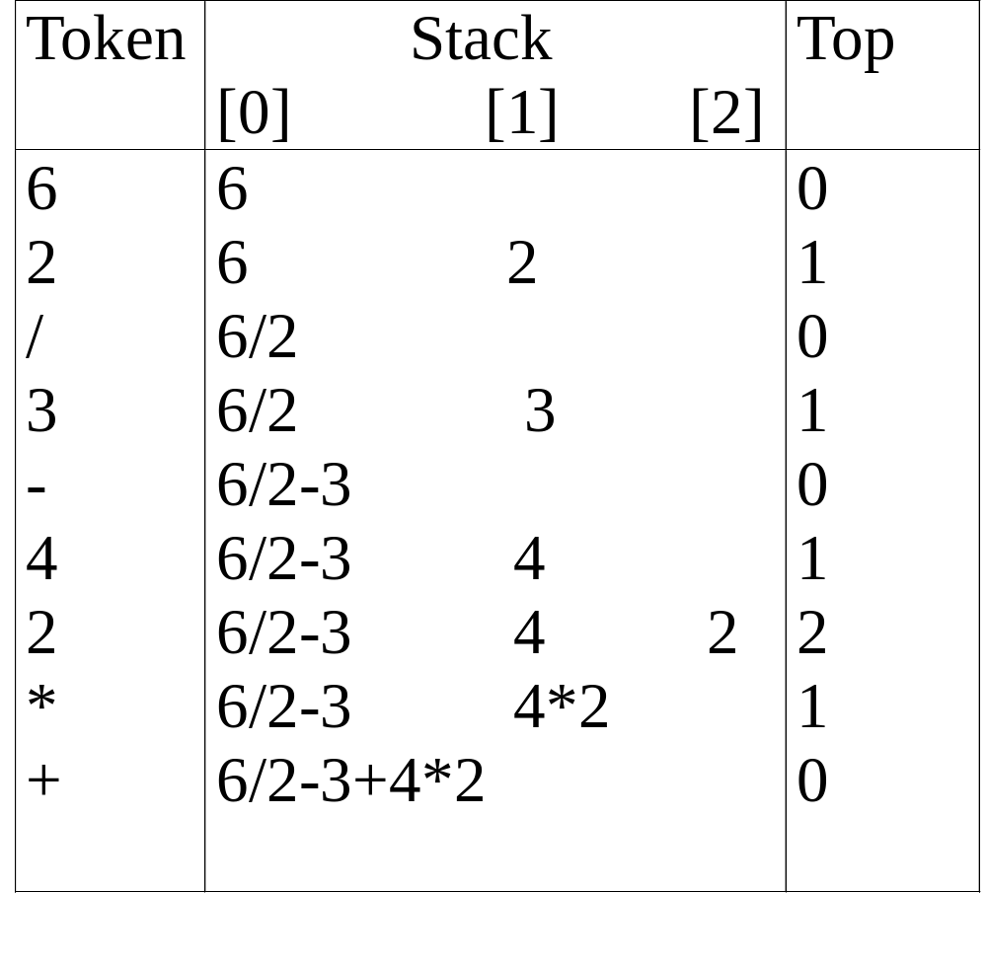
*Figure 3.14: Postfix evaluation (p.120)
CHAPTER 3

Slide 38
#define MAX_STACK_SIZE 100 /* maximum stack size */
#define MAX_EXPR_SIZE 100 /* max size of expression */ typedef enum{1paran, rparen, plus, minus, times, divide, mod, eos, operand} precedence; int stack[MAX_STACK_SIZE]; /* global stack */ char expr[MAX_EXPR_SIZE]; /* input string */
Goal: infix --> postfix
Assumptions:
operators: +, -, *, /, %
operands: single digit integer
CHAPTER 3

Slide 39
int eval(void)
{
/* evaluate a postfix expression, expr, maintained as a global variable, ‘\0’ is the the end of the expression.
The stack and top of the stack are global variables. get_token is used to return the token type and the character symbol. Operands are assumed to be single character digits */ precedence token; char symbol; int op1, op2; int n = 0; /* counter for the expression string */ int top = -1; token = get_token(&symbol, &n); while (token != eos) { if (token == operand) add(&top, symbol-’0’); /* stack insert */
exp: character array
CHAPTER 3

Slide 40
else {
/* remove two operands, perform operation, and return result to the stack */ op2 = delete(&top); /* stack delete */ op1 = delete(&top); switch(token) { case plus: add(&top, op1+op2); break; case minus: add(&top, op1-op2); break; case times: add(&top, op1*op2); break; case divide: add(&top, op1/op2); break; case mod: add(&top, op1%op2);
}
} token = get_token (&symbol, &n);
} return delete(&top); /* return result */
}
*Program 3.9: Function to evaluate a postfix expression (p.122)
CHAPTER 3

Slide 41
precedence get_token(char *symbol, int *n)
{
/* get the next token, symbol is the character representation, which is returned, the token is represented by its enumerated value, which is returned in the function name */
*symbol =expr[(*n)++]; switch (*symbol) { case ‘(‘ : return lparen; case ’)’ : return rparen; case ‘+’: return plus; case ‘-’ : return minus;
CHAPTER 3

Slide 42
case ‘/’ : return divide; case ‘*’ : return times; case ‘%’ : return mod; case ‘\0‘ : return eos; default : return operand;
/* no error checking, default is operand */
}
}
*Program 3.10: Function to get a token from the input string (p.123)
CHAPTER 3

Slide 43
Infix to Postfix Conversion
(Intuitive Algorithm)
(1) Fully parenthesize expression
a / b - c + d * e - a * c -->
((((a / b) - c) + (d * e)) - a * c))
(2) All operators replace their corresponding right
parentheses.
((((a / b) - c) + (d * e)) - a * c))
(3) Delete all parentheses.
ab/c-de*+ac*-
two passes
/
-
*
+
*
-
CHAPTER 3

Slide 44
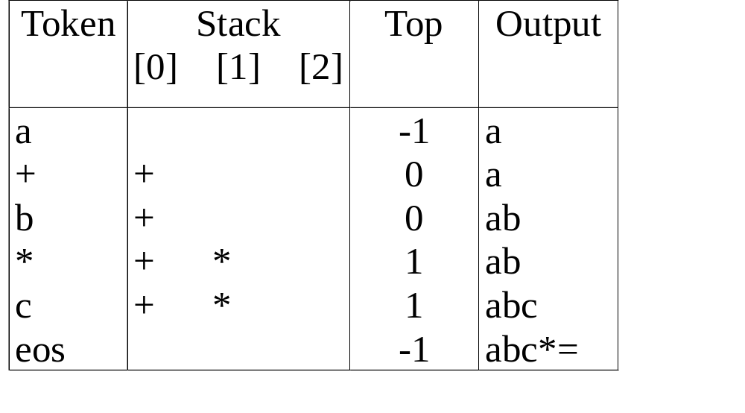
The orders of operands in infix and postfix are the same.
a + b * c, * > +
*Figure 3.15: Translation of a+b*c to postfix (p.124)
CHAPTER 3

Slide 45
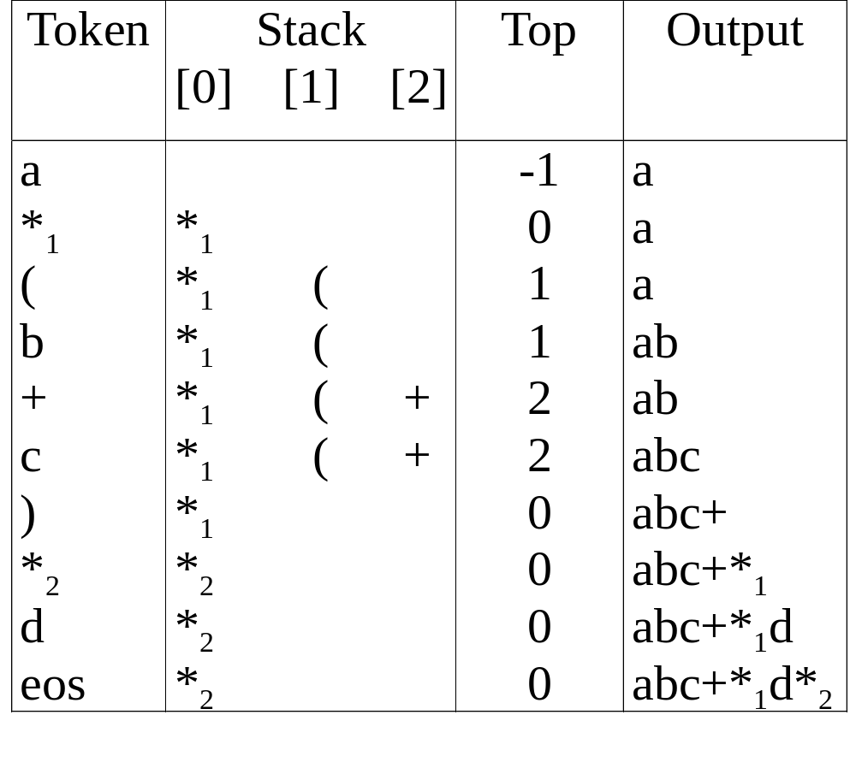
a *₁ (b +c) *₂ d
match )
*₁ = *₂
CHAPTER 3
* Figure 3.16: Translation of a*(b+c)*d to postfix (p.124)

Slide 46
Rules
(1) Operators are taken out of the stack as long as their
in-stack precedence is higher than or equal to the
incoming precedence of the new operator.
(2) ( has low in-stack precedence, and high incoming
precedence.
( ) + - * / % eos
isp 0 19 12 12 13 13 13 0
icp 20 19 12 12 13 13 13 0
CHAPTER 3

Slide 47
precedence stack[MAX_STACK_SIZE];
/* isp and icp arrays -- index is value of precedence lparen, rparen, plus, minus, times, divide, mod, eos */ static int isp [ ] = {0, 19, 12, 12, 13, 13, 13, 0}; static int icp [ ] = {20, 19, 12, 12, 13, 13, 13, 0};
isp: in-stack precedence
icp: incoming precedence
CHAPTER 3

Slide 48
void postfix(void)
{
/* output the postfix of the expression. The expression string, the stack, and top are global */ char symbol; precedence token; int n = 0; int top = 0; /* place eos on stack */ stack[0] = eos; for (token = get _token(&symbol, &n); token != eos; token = get_token(&symbol, &n)) { if (token == operand) printf (“%c”, symbol); else if (token == rparen ){
CHAPTER 3

Slide 49
/*unstack tokens until left parenthesis */ while (stack[top] != lparen) print_token(delete(&top)); delete(&top); /*discard the left parenthesis */
} else{
/* remove and print symbols whose isp is greater than or equal to the current token’s icp */ while(isp[stack[top]] >= icp[token] ) print_token(delete(&top)); add(&top, token);
}
} while ((token = delete(&top)) != eos) print_token(token); print(“\n”);
}
*Program 3.11: Function to convert from infix to postfix (p.126)
f(n)=θ(g(n)) iff there exist positive
constants c₁, c₂, and n₀ such
that c₁g(n)≤f(n)≤c₂g(n) for all
n, n≥n₀.
f(n)=θ(g(n)) iff g(n) is both an
upper and lower bound on f(n).
θ(n)
CHAPTER 3

Slide 50
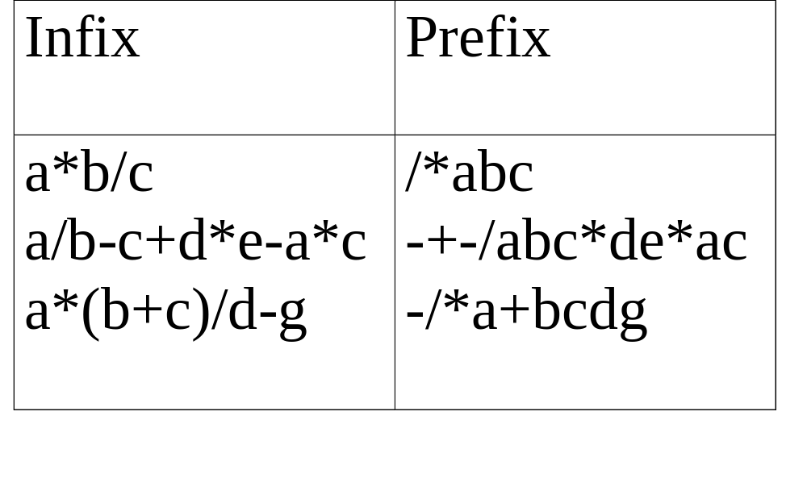
(1) evaluation
(2) transformation
*Figure 3.17: Infix and postfix expressions (p.127)
CHAPTER 3

Slide 51
Multiple stacks and queues
Two stacks
m[0], m[1], …, m[n-2], m[n-1]
bottommost bottommost
stack 1 stack 2
More than two stacks (n)
memory is divided into n equal segments
boundary[stack_no]
0 ≤ stack_no < MAX_STACKS
top[stack_no]
0 ≤ stack_no < MAX_STACKS
CHAPTER 3

Slide 52
Initially, boundary[i]=top[i].
0 1 [ m/n ] 2[ m/n ] m-1
boundary[ 0] boundary[1] boundary[ 2] boundary[n]
top[ 0] top[ 1] top[ 2]
All stacks are empty and divided into roughly equal segments.
*Figure 3.18: Initial configuration for n stacks in memory [m]. (p.129)
CHAPTER 3

Slide 53
#define MEMORY_SIZE 100 /* size of memory */
#define MAX_STACK_SIZE 100
/* max number of stacks plus 1 */
/* global memory declaration */ element memory[MEMORY_SIZE]; int top[MAX_STACKS]; int boundary[MAX_STACKS]; int n; /* number of stacks entered by the user */
*(p.128) top[0] = boundary[0] = -1; for (i = 1; i < n; i++) top[i] =boundary[i] =(MEMORY_SIZE/n)*i; boundary[n] = MEMORY_SIZE-1;
*(p.129)
CHAPTER 3

Slide 54
void add(int i, element item)
{
/* add an item to the ith stack */ if (top[i] == boundary [i+1]) stack_full(i); may have unused storage memory[++top[i]] = item;
}
*Program 3.12:Add an item to the stack stack-no (p.129) element delete(int i)
{
/* remove top element from the ith stack */ if (top[i] == boundary[i]) return stack_empty(i); return memory[top[i]--];
}
*Program 3.13:Delete an item from the stack stack-no (p.130)
CHAPTER 3

Slide 55
(往右)
Find j, stack_no < j < n
such that top[j] < boundary[j+1]
or, 0 ≤ j < stack_no
(往左)
b[0] t[0] b[1] t[1] b[i] t[i] t[i+1] t[j] b[j+1] b[n]
b[i+1] b[i+2]
b=boundary, t=top
*Figure 3.19: Configuration when stack i meets stack i+1,
but the memory is not full (p.130)
meet
往左或右找一個空間
CHAPTER 3

